Slide 1
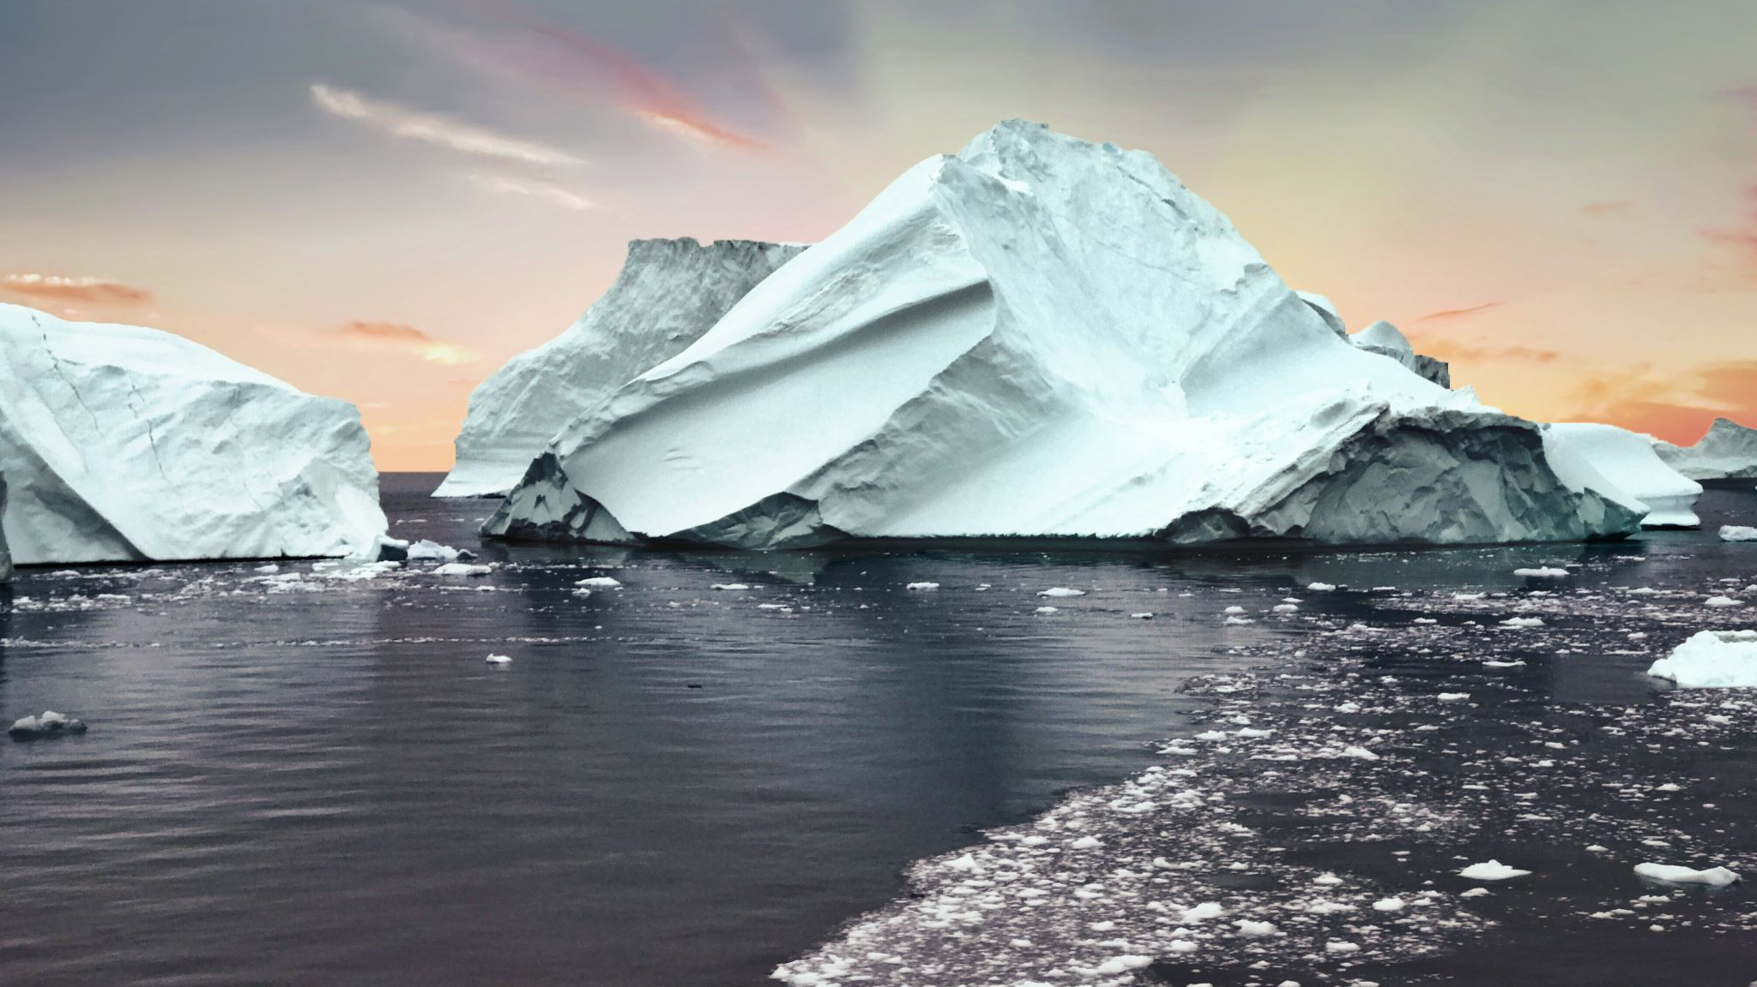
What about climate change?
Dovecot Evangelical Church
‘Food for Thought’

Slide 2
What about climate change?
What’s the issue?
Let’s see the data…
What does the Bible say?
The BIGGER issue
The good news

Slide 3
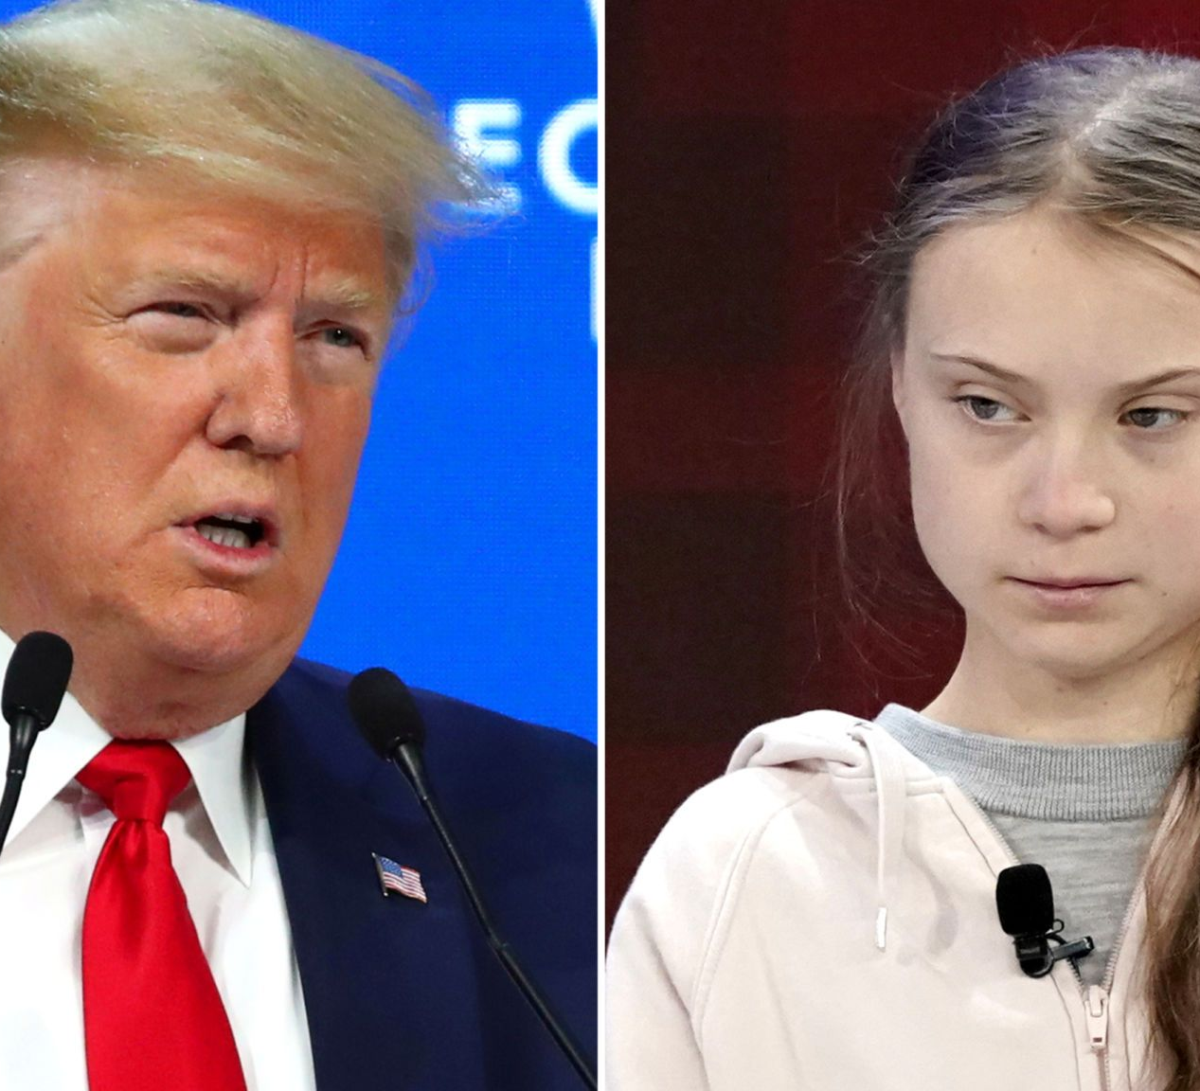
Whatever the issue…
‘A wise man will hear and increase learning….’
Proverbs 1:5

Slide 4
What’s the issue?
Global warming: ‘ a gradual increase in the overall temperature of the earth's atmosphere generally attributed to the greenhouse effect caused by increased levels of carbon dioxide, …and other [pollutants] gases’
OR
‘ the world is getting warmer and its our fault’

Slide 5
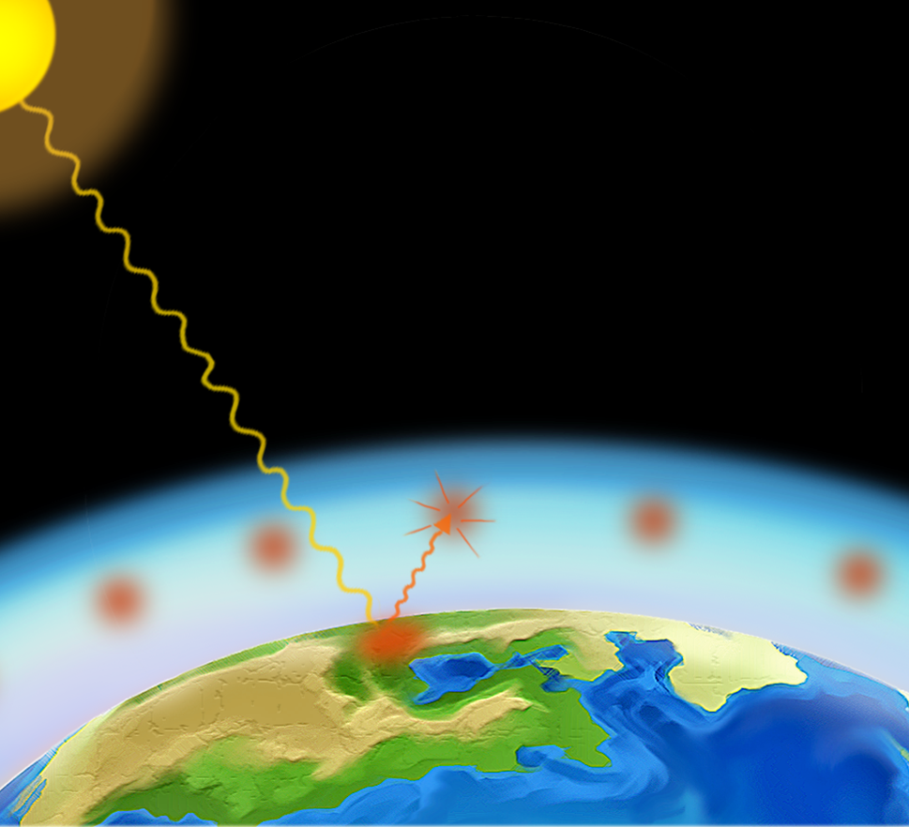
What’s the issue?
The ‘greenhouse effect…’

Slide 6
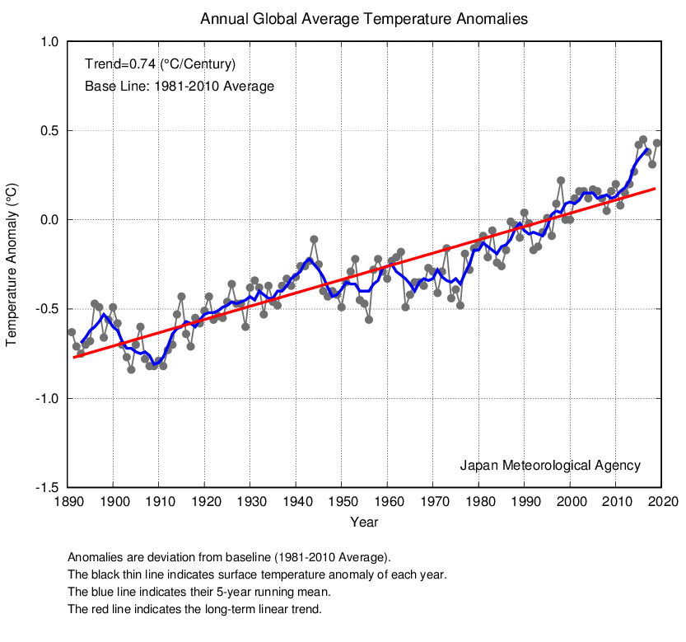
Let’s see the data…
Global temperatures have risen (0.74℃ in 100 years), but there are issues with accurate temperature measurement

Slide 7
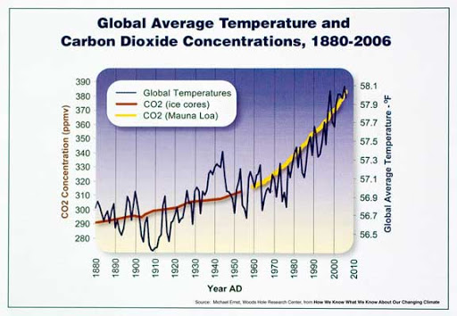
Let’s see the data…
Global temperatures have risen (0.74℃ in 100 years). Carbon dioxide (CO₂) levels are also rising (0.03 % to 0.04 % in 150 years)
BUT the two are NOT always correlated (i.e. sometimes the CO₂ increase occurs after the temperature increase…)

Slide 8
What does the Bible say?
¹⁵ Then God spoke to Noah, saying, ¹⁶ “Go out of the ark, you and your wife, and your sons and your sons’ wives with you. ¹⁷ Bring out with you every living thing of all flesh that is with you: birds and cattle and every creeping thing that creeps on the earth, so that they may abound on the earth, and be fruitful and multiply on the earth.” ¹⁸ So Noah went out, and his sons and his wife and his sons’ wives with him. ¹⁹ Every animal, every creeping thing, every bird, and whatever creeps on the earth, according to their families, went out of the ark.

Slide 9
What does the Bible say?
²⁰ Then Noah built an altar to the Lord, and took of every clean animal and of every clean bird, and offered burnt offerings on the altar. ²¹ And the Lord smelled a soothing aroma. Then the Lord said in His heart, “I will never again curse the ground for man’s sake, although the imagination of man’s heart is evil from his youth; nor will I again destroy every living thing as I have done.
²² “While the earth remains, seedtime and harvest, cold and heat, winter and summer, and day and night shall not cease.”

Slide 10
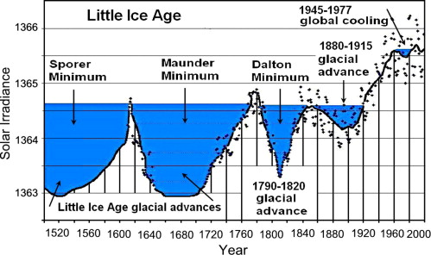
Things to bear in mind…
The ‘medieval warm period’ was followed by a ‘little ice age’
European temperatures have increased since 1680 to today by approximately 2℃

Slide 11
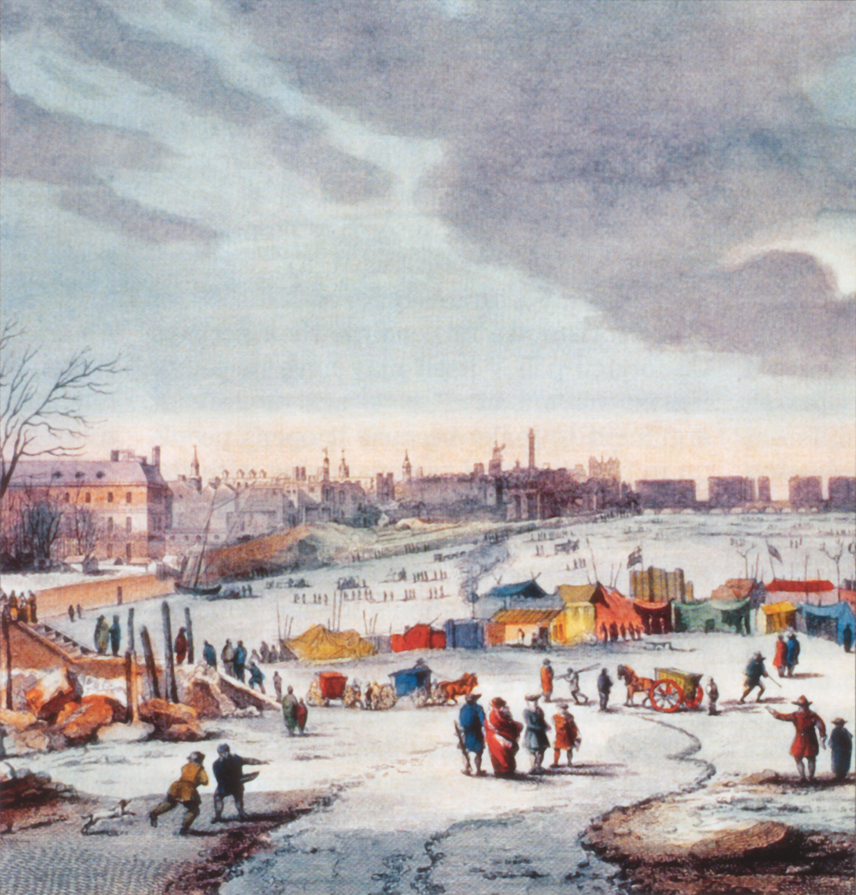
Things to bear in mind…
During the ‘medieval warm period’ temperatures in Greenland exceeded 1961-1990 levels (Mann et al 2009)
Opposite: River Thames 1683-84 during the ‘little ice age’ (Thomas Wyke)

Slide 12
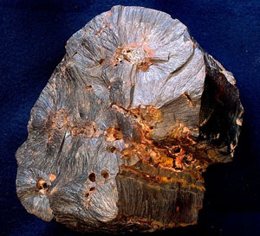
Things to bear in mind…
Goethite, an iron oxide mineral, retains carbon dioxide present when it forms. Goethite strata buried early in the Flood show a world with 15x more CO₂ in the atmosphere than today.
Levels of CO₂ were MUCH higher in the past…

Slide 13
Some conclusions (part I) …
This is God’s world: he made it has promised to sustain it
We are stewards of the planet: we ought to live as such
Temperatures in Europe have increased since 1680
Large scale temperature variation has occurred in the past (e.g. the ice-age)
CO₂ levels were much higher in the past (e.g. before the Flood)
Scientists don’t all agree but do all make mistakes
We need a correct view of earth’s purpose, history and destiny: God’s word, the BIBLE

Slide 14
The BIGGER issue…
Atheism in UK: ‘at its highest ever level’
STDs: ‘…447,694 new cases in 2018’
Rape and sexual abuse: ‘increased dramatically since 2012/13…’
Relationships education: all UK primary schools from 2020
Free speech threatened: Israel Folau, Franklin Graham, Richard Page
Holocaust memorial January 2020: yet anti-Semitism is back in UK
UK Abortions: ‘all time high’ 200,000+ in 2019
There is a moral climate change, and it IS serious

Slide 15
The BIGGER issue…
‘The fool says in his heart: there is no God’
Psalm 14:1
‘Behold, they have rejected the word of the Lord, so what wisdom do they have ?
Jeremiah 8:9
It is appointed unto men once to die and after death the judgement’
Hebrews 9:27

Slide 16
The Good News…
‘For God so loved the world that He gave His only begotten Son, that whoever believes in Him should not perish but have everlasting life’
John 3:16

